Slide 1
Overview of Data Analysis

Slide 2
차례
데이터 분석이란
Predictive Analysis
Overview of Predictive Analysis
Predictive Analysis의 문제
Descriptive Analysis
Overview of Descriptive Analysis
Descriptive Analysis의 문제

Slide 3
데이터 분석이란
데이터 분석의 목적
Valid: The pattern has to be true with a certain level of certainty
Novel: The pattern should be previously unknown or obvious
Useful: The pattern should provide information useful for your tasks or goals
Understandable: Human experts should be able to interpret it
To Identify Valid, Novel, potentially useful, and ultimately understandable patterns in data

Slide 4
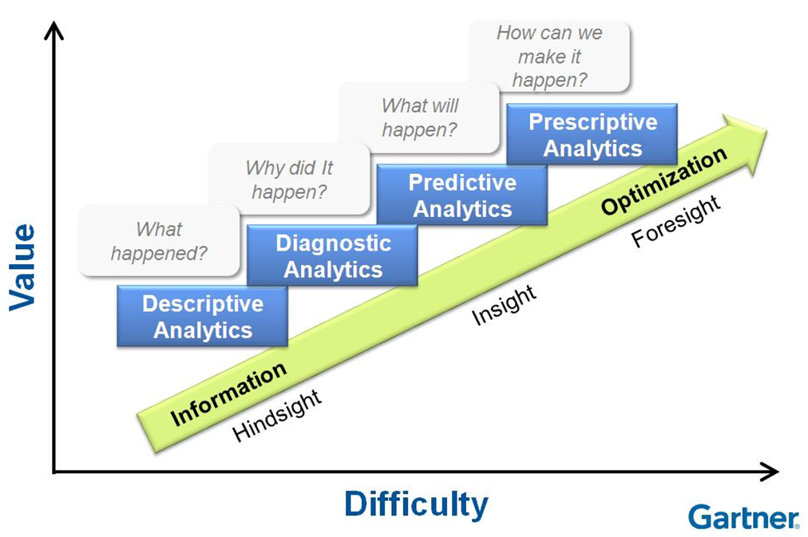
데이터 분석이란
데이터 분석 수준

Slide 5
데이터 분석이란
데이터 분석의 다양한 문제
Classification
Regression
Anomaly Detection
Recommendation
…
Clustering
Association
Dimension Reduction
Hidden Structure Analysis
…
Predictive Analysis의 문제
Descriptive Analysis의 문제

Slide 6
Predictive Analysis

Slide 7
Overview of Predictive Analysis
데이터에 내재된 패턴을 분석하여, 아직 수행되지 않은 일의 결과를 예측하는 것
생산 공정 중 데이터
예측
데이터의 최종 품질
개인의 경제활동
데이터
예측
신용평가

Slide 8
Overview of Predictive Analysis
예측 모델 생성 과정
데이터
적용
분석기법
생성
데이터 예측 모델
새로운
데이터
예측 결과

Slide 9
Overview of Predictive Analysis
데이터
관찰된 데이터와 그것의 최종 결과가 포함된 데이터가 있어야함
생산 공정 중 데이터
예측
데이터의 최종 품질
 | 온도 | 압력 | 길이 | … | 품질
S₁ | 900 | 4.0 | 5.0 | … | Good
S₂ | 950 | 4.1 | 4.9 | … | Good
S₃ | 935 | 3.9 | 5.1 | … | Bad
S₄ | 940 | 4.0 | 4.9 | … | Good
… | … | … | … | … | …

Slide 10
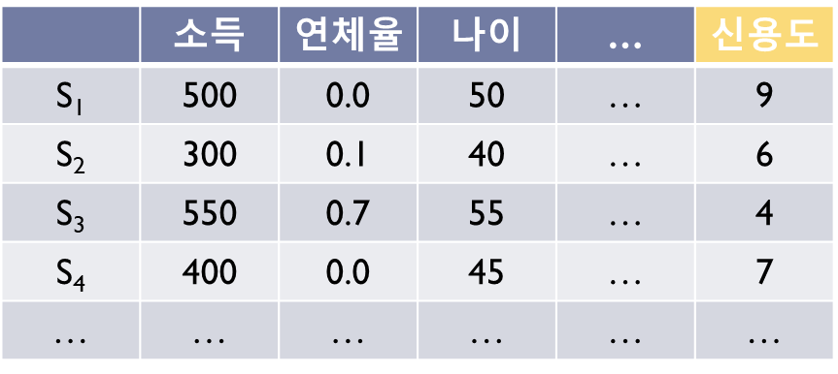
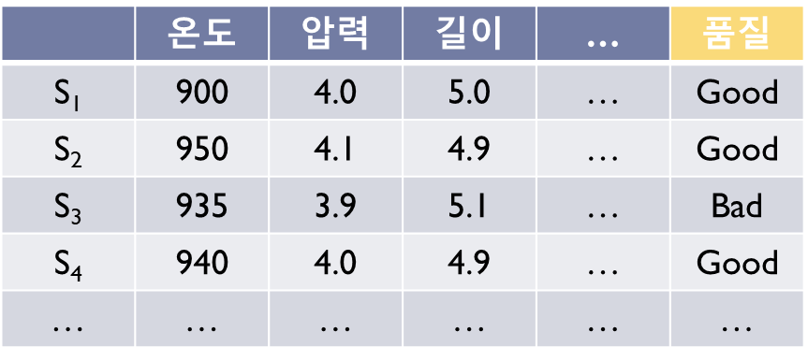
Overview of Predictive Analysis
데이터
관찰된 데이터와 그것의 최종 결과가 포함된 데이터가 있어야함
X
예측
Y
X
Y
X
Y

Slide 11
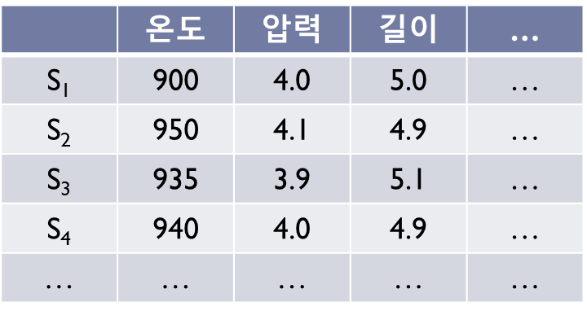
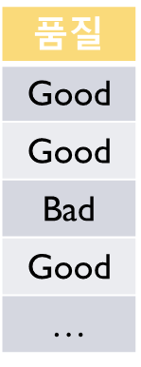
Overview of Predictive Analysis
분석기법
수집된 데이터
어떤 관계가
있을까?

Slide 12
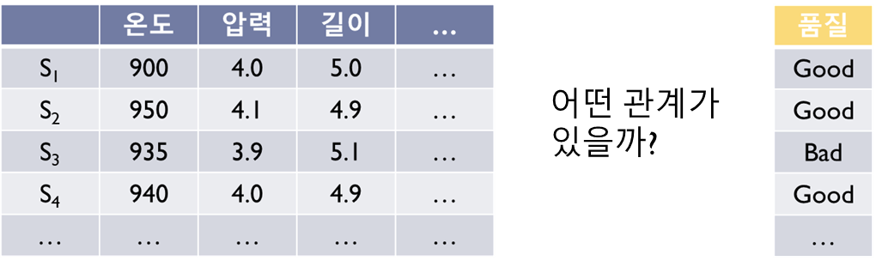
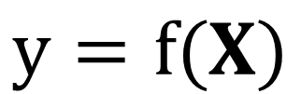
Overview of Predictive Analysis
분석기법
X
Mapping
Y
$$y=f(X)$$

Slide 13
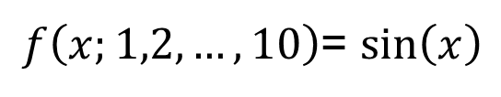

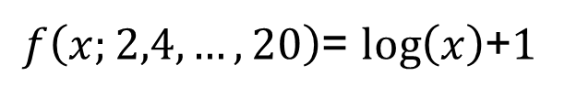
Overview of Predictive Analysis
분석 기법
대부분의 분석 기법은 Universal Approximator를 기반으로 한다
Universal Approximator
허용된 오차 범위 내에서 어떤 함수도 흉내 낼 수 있는 함수
$$f\left(x_{1},x_{2},…, x_{n};w_{1},w_{2},…,w_{m}\right)$$
함수입력 파라미터
모양 결정 파라미터
$f\left(x;1,2,…,10\right)$= $sin\left(x\right)$
$f\left(x;2,4,…,20\right)$= $log\left(x\right)$+1

Slide 14

Overview of Predictive Analysis
Learning
선택한 분석기법이 주어진 데이터의 함수 관계를 잘 표현하도록 “모양 결정 파라미터＂를 결정하는 과정
주어진 데이터를 가장 잘 설명하는 함수를 찾아라
y
$$y=f\left(x\right)$$
x

Slide 15

Overview of Predictive Analysis
Learning
여러 종류의 Approximator 중에서 하나를 선택한다
Neural Network, Deep Learning, Decision Tree, Random Forest 등
$$f\left(x_{1},x_{2},…, x_{n};w_{1},w_{2},…,w_{m}\right)$$

Slide 16

Overview of Predictive Analysis
Learning
f가 주어진 데이터에 가장 잘 부합도록 w를 잘 조정한다
$$f\left(x;1.0,1.0,1.0\right)$$
y
x

Slide 17

Overview of Predictive Analysis
Learning
f가 주어진 데이터에 가장 잘 부합도록 w를 잘 조정한다
$$f\left(x;1.5,1.0,1.5\right)$$
y
x

Slide 18

Overview of Predictive Analysis
Learning
f가 주어진 데이터에 가장 잘 부합도록 w를 잘 조정한다
$$f\left(x;1.5,−1.0,1.5\right)$$
y
x

Slide 19

Overview of Predictive Analysis
Learning
f가 주어진 데이터에 가장 잘 부합도록 w를 잘 조정한다
$$f\left(x;1.7,−1.2,1.6\right)$$
y
x

Slide 20
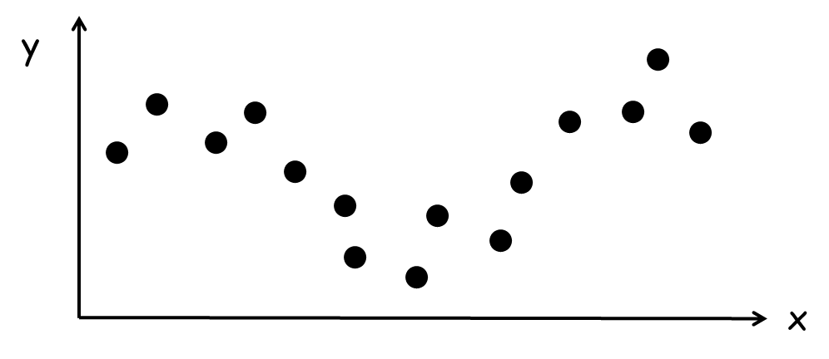
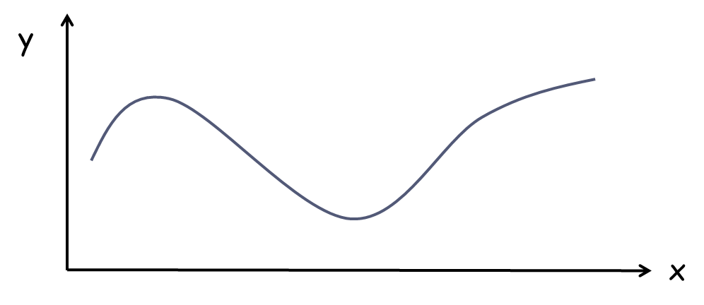

Overview of Predictive Analysis
Learning
학습(Learning)후 데이터 모델이 완성 된다
$$y=f\left(x;1.7,−1.2,1.6\right)$$
데이터
데이터 모델

Slide 21

Overview of Predictive Analysis
예측
데이터 모델을 이용한다
$$f\left(10.0 ;1.7,−1.2,1.6\right)$$
y
x
10.0

Slide 22

Basic Idea of Learning
예측
데이터 모델을 이용한다
$$5.0=f\left(10.0 ;1.7,−1.2,1.6\right)$$
y
5.0
x
10.0

Slide 23
Predictive Analysis의 문제들

Slide 24
Predictive Analysis
Classification
Predicting labels of new data
Regression
Predicting the output value of new data
Anomaly Detection
Finding unusual instances
Recommendation
Recommending new interesting items

Slide 25
Classification
Data: Given a collection of records with labels
(X₁, Good), (X₂, Bad), (X₃, Bad), (X₄, Good), …
Goal: To predict the labels of unseen records
Find a model for the class as a function of the observed attributes.
?

Slide 26
Regression (1)
Data: Given a collection of records with a values
(X₁, y₁), (X₂, y₂), (X₃, y₃), (X₄, y₄), …
Goal: To predict the values of unseen records
Find a model for the value as a function of the observed attributes.
X | y
1.1 | 1.00
1.3 | 1.20
2.0 | 1.05
2.5 | 1.22
3.5 | 0.95
4.5 | 0.89
… | …
What value of y if X=3.0 ?

Slide 27
Regression (2)
Approach
y
Model
x
x'

Slide 28
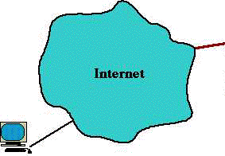
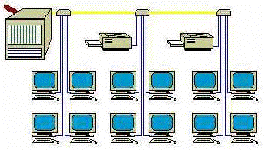
Anomaly Detection (1)
Data: A collection of data you are observing
Goal: To detect something not usual has happened
Credit Card Fraud Detection
Network Intrusion Detection
Spam Filtering
Event Detection

Slide 29
Anomaly Detection (2)
Approach
Anomaly Detection can be solved by Classification
But, the patterns of anomalies frequently change
Frequently update the patterns
Need automatic anomaly detections
S-IP | D-IP | Port | Coutnt | Intrusion
157.246.254.49 | 110.124.82.101 | 85 | 1 | No
131.155.188.76 | 110.124.212.100 | 90 | 5 | No
43.167.98.64 | 110.124.115.91 | 78 | 10 | Yes
237.183.250.90 | 110.124.91.11 | 96 | 1 | Yes
202.138.121.203 | 110.124.82.100 | 70 | 3 | No
29.234.2.254 | 110.124.32.151 | 70 | 1 | No
122.171.152.230 | 120.124.187.81 | 80 | 4 | No
94.156.5.209 | 120.124.190.230 | 70 | 3 | No
16.223.194.156 | 120.124.9.23 | 90 | 50 | Yes

Slide 30
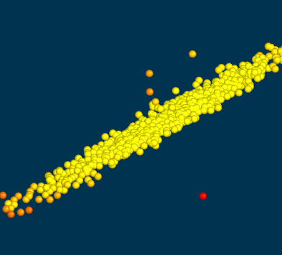
Anomaly Detection (3)
Approach: Gaussian model
Estimate the density of the training data using a few Gaussian models
Difficult to determine the number of Gaussian models

Slide 31
Recommendation (1)
Data: User-Item consumption data
Goal: Recommend new items to users which are close to their preference
Movie, Music, TV program, Whatever next choice
 | I₁ | I₂ | I₃ | I₄ | I₅
U₁ | ? | 3 | ? | 5 | 4
U₂ | 2 | ? | 2 | 3 | 3
U₃ | ? | 2 | 4 | ? | ?
U₄ | 2 | 3 | 3 | 2 | 5
U₅ | 1 | ? | 1 | ? | 2

Slide 32
Recommendation (2)
Approach
Content-based Filtering
Recommend items similar to the active user’s preference
Collaborative Filtering
Recommend items which users with similar preference to the active user’s preference have chosen
 | I₁ | I₂ | I₃ | I₄ | I₅
U₁ | ? | 3 | ? | 5 | 4
U₂ | 2 | ? | 2 | 3 | 3
U₃ | ? | 2 | 4 | ? | ?
U₄ | 2 | 3 | 3 | 2 | 5
U₅ | 1 | ? | 1 | ? | 2

Slide 33
Descriptive Analysis의 문제들

Slide 34
Overview of Descriptive Analysis
데이터의 패턴을 분석하여 데이터의 특징을 파악하기 위한 분석
이 데이터는 크게 3 덩이로 나눌 수 있다
데이터 내부에서 자주 나타나는 패턴은 이것이다
각 X 변수 간의 인과관계는 이것이다
데이터를 X 인자를 최대한 줄이면 이렇다
생산 공정 중 데이터
분석

Slide 35
Descriptive Analysis
Clustering
Grouping similar instances
Association
Finding frequently co-occurring items
Dimension Reduction
Finding effective representation of a group

Slide 36
Clustering (1)
Data: Given a collection of records
Goal: To group similar records together
Definition of similarity is dependent on application domains

Slide 37

Clustering (2)
Example: Advertising (approach)
1. Define similarity between customers
If you think that geographically close people share more characteristics, the distance between customers can be a similarity
2. Apply clustering algorithms and find clusters
Mapping
Customers

Slide 38
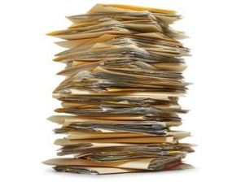
Clustering (3)
Example: Document Clustering
You have a lot of documents.
You want to find the documents with similar topics and group them
Football
Baseball
Basketball
Volleyball

Slide 39
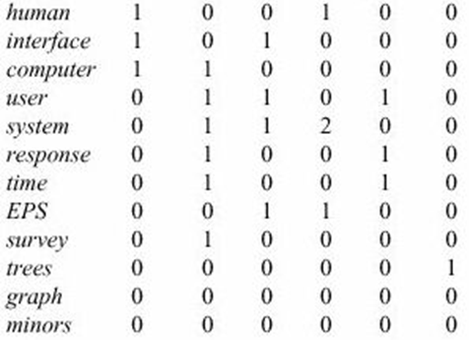
Clustering (4)
Example: Document Clustering (approach)
1. Define similarity between documents
If two documents share the same topic, they will share more words
2. Apply clustering algorithms and find clusters
D₁ D₂ D₃ D₄ D₅ D₆

Slide 40
Association
Data: A collection of Sets
{a,b,c}, {b,c}, {a,c,d}, {b,c,f}, …
Goal: To find frequently co-occurring items
Find dependency rules which will predict occurrence of an item based on occurrences of other items.
If Milk appears,
Coke appear with a high probability
If Diaper and Milk appears,
Beer appear with a high probability
{Milk} -> {Coke}
{Diaper, Milk} -> {Beer}

Slide 41
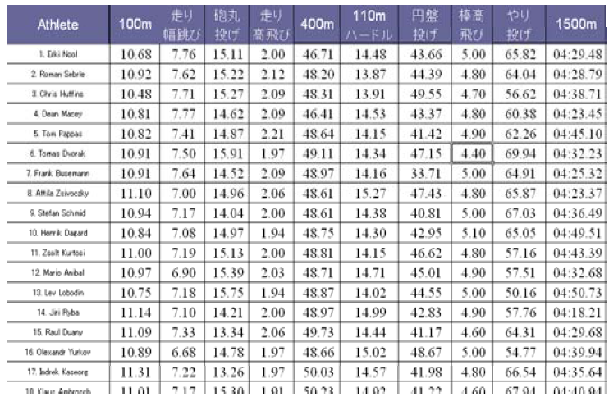
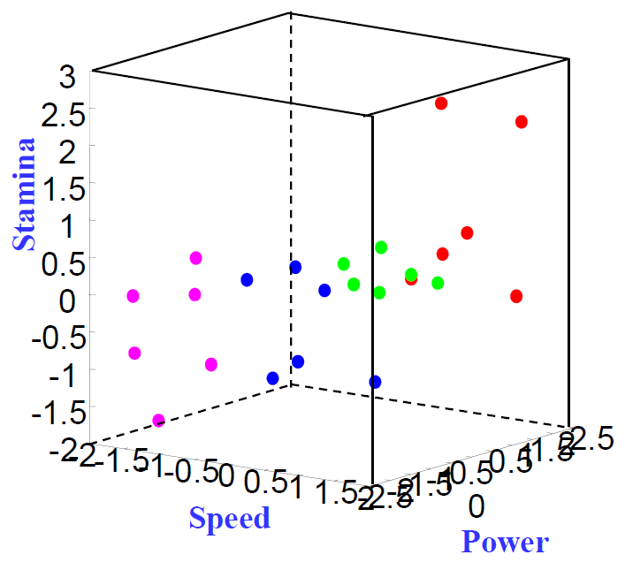
Dimension Reduction (1)
Data: A collection of data
Goal: Finding an efficient (low dimensional) representation of data
For visualization
As a preprocessing of further data analysis

Slide 42
Dimension Reduction (2)
Principal Component Analysis
Minimizing information loss

Slide 43
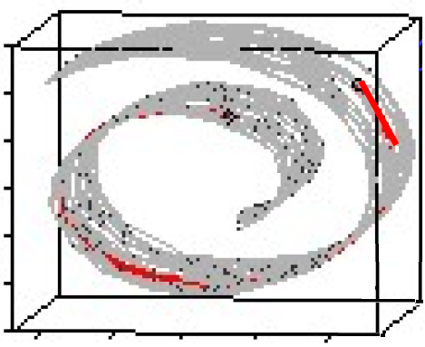
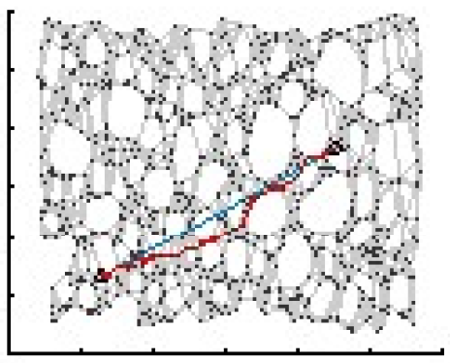
Dimension Reduction (3)
ISOMAP
Preserving local distance

Slide 44
Thank you

